Slide 1
Presentation Zen Assignment - Problem Statement
What is your role?
Product Manager of EMC.
Who are your audience?
EMC Customers.
What is your topic of presentation?
To present the product “Network Validator” for the “Integrated Data Protection Appliance (IDPA)” storage device and get their buy-in.
What do you want to achieve with this presentation?
Customer approval.

Slide 2

My name is Asit Piri,
I am Data Product Manager for
Integrated Data Protection Appliance
Who am I?

Slide 3

Where I work and
what we do?
I work for Dell EMC since 2000, where we build environment friendly technology.
SINCE 2010
We do business more than 100 countries
We touch life of 3B people directly or indirectly

Slide 4

What is our collective purpose?
Our purpose is to connect the world through network and server technology and incrementally advance the way how people live and work.
SINCE 2010
Building Data Product for

Slide 5
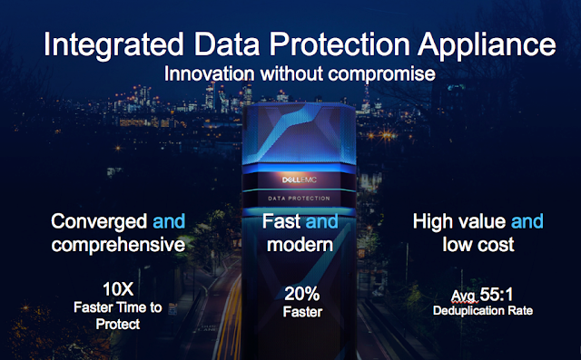

Slide 6

Easy management through Modern UI
Dashboards
Exception Resolutions
Policy Management
Reporting
Simplicity is Easy management Through Modern UI
Dashboards
Exception Resolutions
Policy Management
Reporting

Slide 7
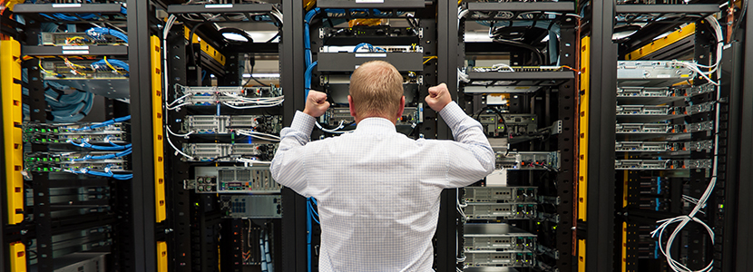
User Research:
Usability Testing
User Interview
Data CenterVisit
Ethnography
User Survey
Persona: Network Engineer
Configuring and managing a computer network, engineers have been forced to do everything manually.
Generated the device configurations and make required changes to them.
Commit them to the network and check that the network behaves as expected afterwords.
These tasks are not only laborious but also anxiety-inducing, since a single mistake can bring down the network or open a gaping security hole.

Slide 8
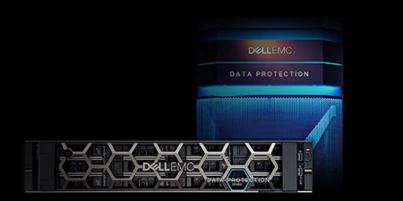
With our new product “Network Validator” we solve two major pain points for engineers.
Improve 50% efficiency
Improve 40% accuracy

Slide 9
What problem our new product Network Validator solves?
With our new product “Network Validator” we will solve two major pain points for engineers.
Data workload automation
“arguments the hands and eyes of network engineers and helps them log into devices, extract information, copy data and so no.”
Automated validation “arguments their brains and help them predict the impact of different actions. Reason about correctness, and diagnose unexpected network behaviour.”
Verification
Functional Testing
Unit Testing
Robotic Process Automation
Artificial Intelligence

Slide 10



How well our new product Network Validator validate?
Network Automation Vocabulary (New Solution)
Big,red,
apple
Big,green,
apple
Big,orange,
orange
Fruit
Fruit
Fruit
Network Validation Vocabulary (Current Solution)

Slide 11

Guaranteed. FUTURE-PROOF
LOYALTY PROGRAM
3-Years Satisfaction Guarantee
Up to 55:1 Data Protection Deduplication Guarantee
Investment Protection
Cloud Mobility, Protection, Data Services & Management
Predictable Support Pricing
Cloud-Enabled Infrastructure

Slide 12



Thank you!

